Slide 1

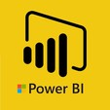
Hii,
Iam Siddhika
Welcome to Power BI Series
Part -49

Slide 2



We focus only on the most used and important Dax Functions
Today Content
Meet DAX
I’m soo Excited. It’s my favourite functions.
Are you ready guys?
COMMON FUNCTION CATEGORIES
7.TIME INTELLIGENCE FUNCTIONS(FEW MORE)
PREVIOUSYEAR PREVIOUSQUARTER PREVIOUSMONTH PREVIOUSDAY

Slide 3

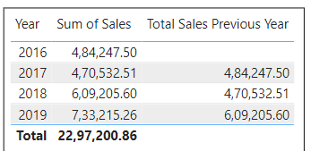

PREVIOUSYEAR
PREVIOUSYEAR is used to return all the dates from the previous year, allowing you to create year-over-year comparisons.
It's often used in financial and business reporting to track performance metrics such as sales, revenue, or expenses from the previous year.
Check this
Syntax
PREVIOUSYEAR(<dates>[,<year_end_date>])
dates: A column containing dates.
year_end_date (optional): A string literal representing the end date of the fiscal year. If omitted, the default is December 31.
Example
How can you create a measure to calculate the total sales amount for the previous year using the Orders table and the OrderDate column?
Total sales Previous Year column for 2017 gives the sales amount of 2016, for 2018 gives the sales amount of 2017 .
It gives the sales amount of previous year.

Slide 4

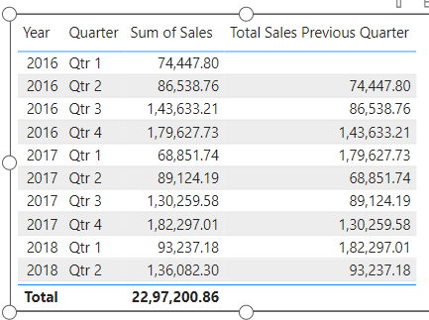

PREVIOUSQUARTER
PREVIOUSQUARTER is used to return all the dates from the previous quarter, allowing you to create quarter-over-quarter comparisons.
It's often used in financial and business reporting to track performance metrics such as sales, revenue, or expenses from the previous quarter.
Easy?
Syntax
PREVIOUSQUARTER(<dates>)
dates: A column containing dates.
Example
How can you create a measure to calculate the total sales amount for the previous quarter using the Orders table and the OrderDate column?
Here Previous quarter column for 2016 qtr 2 gives sales amount of its previous qtr of 2016 qtr 1.
Like this it gives the sales amount of its previous qtr.

Slide 5

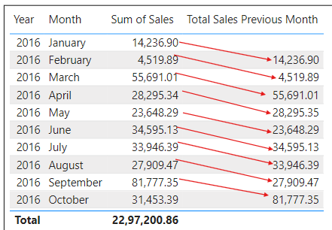
PREVIOUSMONTH
PREVIOUSMONTH is used to return all the dates from the previous month, allowing you to create month-over-month comparisons.
It's often used in financial and business reporting to track performance metrics such as sales, revenue, or expenses from the previous month.
Got it?
Syntax
PREVIOUSMONTH(<Dates>)
dates: A column containing dates.
Example
How can you create a measure to calculate the total sales amount for the previous Month using the Orders table and the OrderDate column?
Here Previous Month column for 2016 Feb gives sales amount of its previous Month of 2016 Jan. Like this it gives the sales amount of its previous Month.

Slide 6
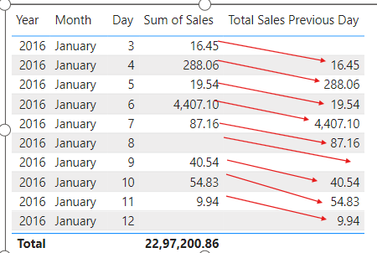
PREVIOUSDAY
PREVIOUSDAY is used to return all the dates from the previous day, allowing you to create day-over-day comparisons.
It's often used in financial and business reporting to track daily performance metrics such as sales, revenue, or expenses from the previous day.
Easy?
Syntax
PREVIOUSDAY(<dates>)
dates: A column containing dates.
Example
How can you create a measure to calculate the total sales amount for the previous Day using the Orders table and the OrderDate column?
Here Previous quarter column for 2016 jan day 4 gives sales amount of its previous day of 2016 jan day 3.
Like this it gives the sales amount of its previous day.

Slide 7


Thank you for joining me today to learn about Part -49 of Power BI!
Remember, Learning DAX is key to unlocking the full potential of Power BI for insightful reporting and visualization.
Stay tuned for more insights and tips on Power BI in our next Series.
Follow

